Slide 1
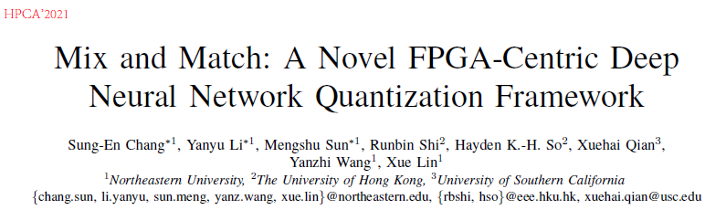

Slide 2


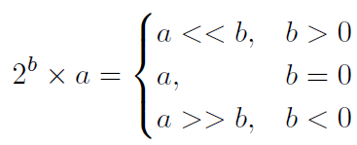
Basics
Fixed-point quantization （均匀量化）:
Power-of-2 quantization（非均匀量化）：
m: quantization bit
α: scaling factor

Slide 3
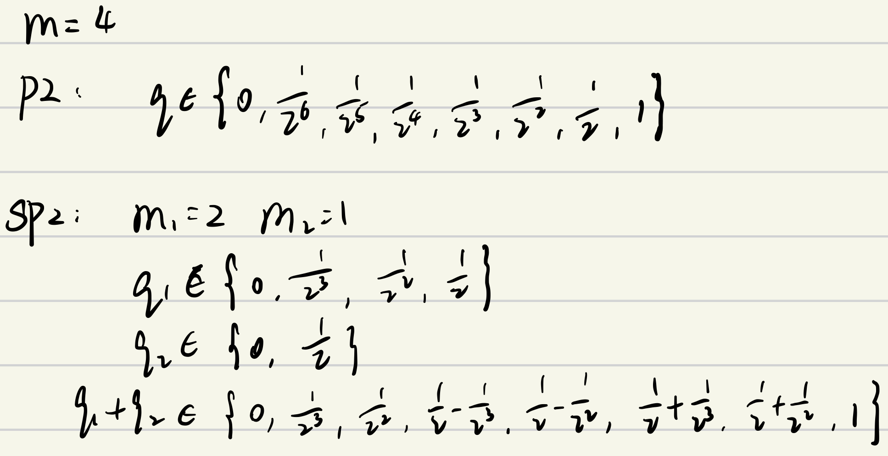
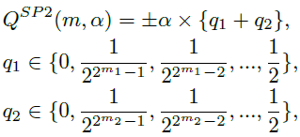
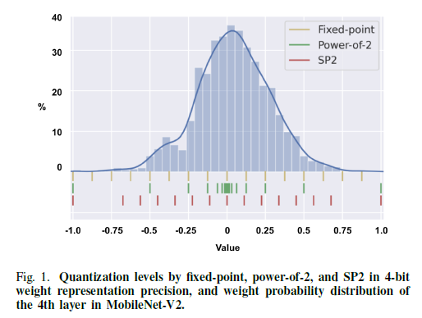
Sum-of-Power-of-2 (SP2)
To address the non-negligible accuracy loss of power-of-2 quantization
q1,q2: power-of-2 numbers
m1+m2+1=m
m1≥m2
Levels:

Slide 4
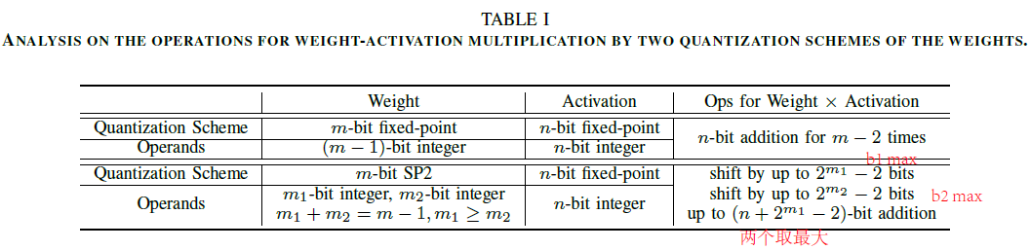
Sum-of-Power-of-2 (SP2)
Fixed-point Quantization:
Suitable for Uniform-like weight distribution
Can be implemented efficiently by DSP
SP2 Quantization:
Suitable for Gaussian-like weight distribution
Can be implemented efficiently by LUT
ADDITIVE POWERS-OF-TWO QUANTIZATION: A NONUNIFORM
DISCRETIZATION FOR NEURAL NETWORKS ICLR’2020

Slide 5
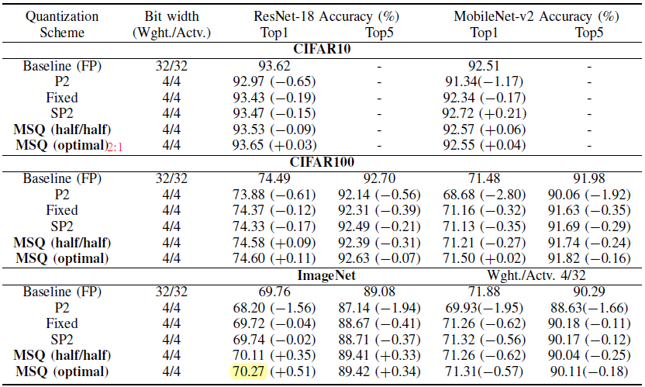
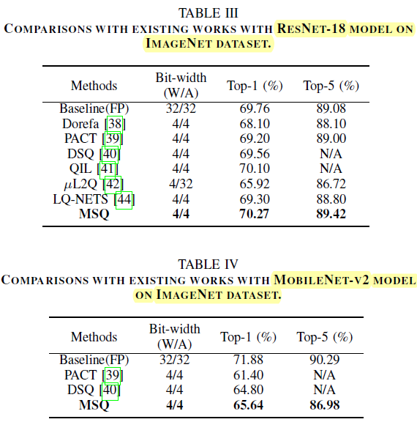
Mixed scheme quantization (MSQ)
The distribution of the weights in the different rows are not the same.
To achieve better utilization of heterogeneous FPGA hardware resources.

Slide 6
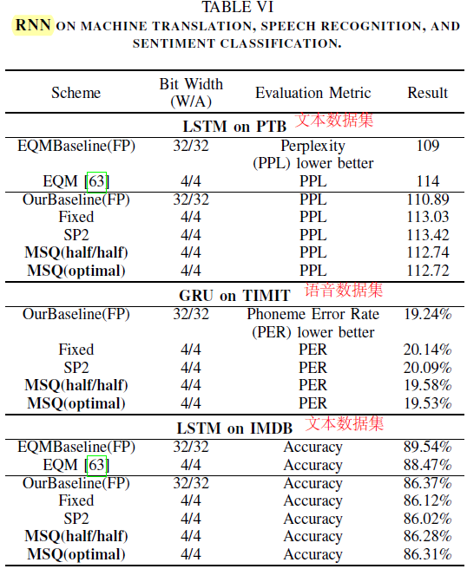
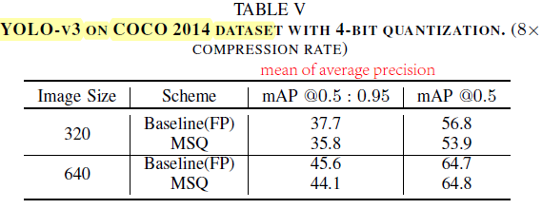
Mixed scheme quantization (MSQ)
Object detection
RNN model (NLP)

Slide 7
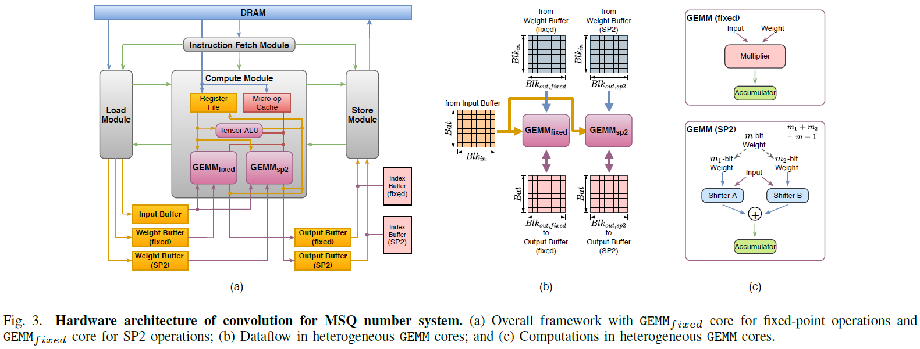
FPGA Implementation
Four modules: Instruction, Load, Store, Compute
A hardware–software blueprint for flexible deep learning specialization Micro’2019

Slide 8
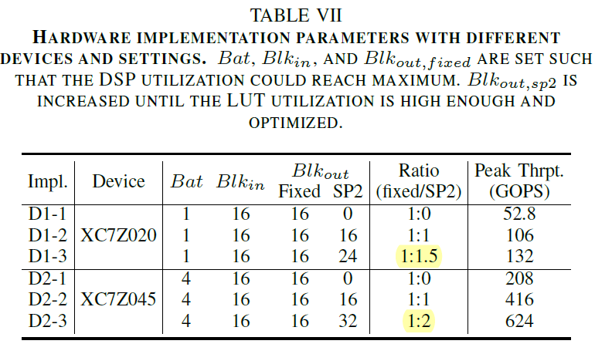
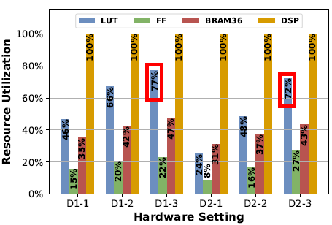
FPGA Implementation
DSP: Fully utilized for conventional multiplication
LUT: Leveraged for computations with SP2 weights
Specifically, we progressively increase the size of GEMMsp2 core (Blkout;sp2), till the LUT utilization reaches 70%. For example, on XC7Z020 the desired fixed/SP2 ratio is 1:1.5 and on XC7Z045 it is 1:2

Slide 9
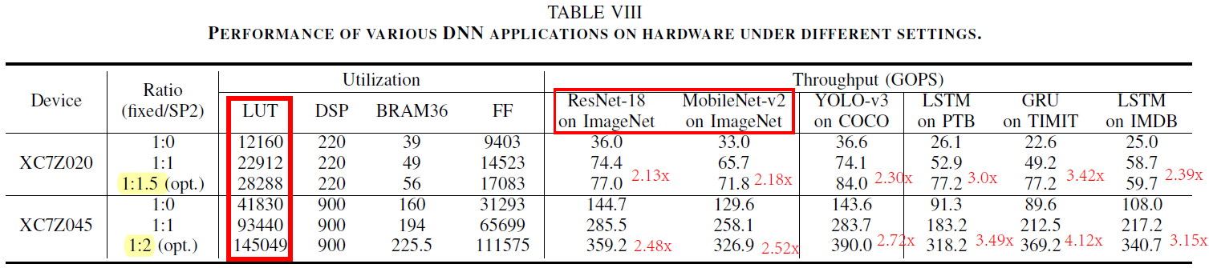
FPGA Implementation
Throughput evaluation
Performance improvement: 2.1x-4.1x

Slide 10
Conclusion
Software-Hardware co-design
A hardware-friendly quantization scheme: SP2
Intra-layer, multi-scheme quantization scheme: MSQ
Fully explore the FPGA resources
Performance improvement: 2.1x-4.1x

